Slide 1
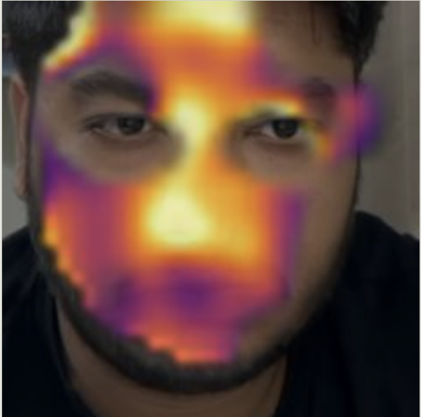


SonicVitals: Contactless Vital-Sign Sensing with a Low-Cost Optical–Acoustic Edge Node, Skin-Metered Exposure Control and Quality-Gated Remote Photoplethysmography
Final project review · October 2026
Blood-flow map, captured live from a webcam
Janhavee Dhote
24BML0120
Pratik Kumar
24BML0027
Uday Krishan Khandelwal
24BML0012
Guide: Jeeva J. B.
School of Electronics Engineering (SENSE), VIT

Slide 2



Why measure vital signs without contact?
0.1–0.5 %
change in skin brightness with every heartbeat: invisible to the eye, measurable by a camera
≈ ₹2,150
for the complete edge node: camera, microphone, display and microcontroller
0 contact
no electrodes, finger clips or chest straps on the person
Contact sensors have limits
Electrodes and clips must be attached and cleaned, can irritate fragile skin (newborns, burns, elderly) and restrict movement.
Continuous and remote care
Telehealth, home and elderly monitoring need checks that work without trained staff or consumables.
Readings must be trustworthy
Camera methods break with motion and lighting. A usable system must know, and say, when a value cannot be trusted.
Our answer: one camera node measures heart rate, breathing, HRV, blood flow and liveness, and every value carries a trust badge.

Slide 3





Research gap and problem statement
Accuracy collapses with motion and light
Most rPPG methods assume a still face under constant lighting.
PROBLEM STATEMENT
Design a low-cost, contactless system that measures heart rate and breathing rate from face video in real time, on an embedded edge node or a webcam, rejects motion and lighting artifacts, reports how far each value can be trusted, and explains it on a clear dashboard.
Heart-rate accuracy validated on UBFC-rPPG against contact PPG.
Few systems report reliability
A number is shown even when the spectrum holds no clear heartbeat.
Low-cost edge hardware is rarely used
Skin statistics before compression and skin-metered exposure are uncommon.
One vital sign, little explanation
Heart rate alone, without breathing, HRV, liveness or a view of the signal.

Slide 4





Objectives
01 Edge sensor node
ESP32-S3 with camera, MEMS microphone and OLED, streaming time-synchronised data over Wi-Fi
02 Robust heart rate
CHROM, POS and GREEN with motion compensation, artifact repair and a quality gate
03 One trusted number
Combine classic and three deep-learning models into a stabilised, flag-protected heart rate
04 Breathing and HRV
Four-source breathing rate with its pattern, and heart-rate variability from the camera
05 Face insights
Blood-flow map, perfusion index, liveness, blink rate, head steadiness and colour indices
06 Validation
Benchmark heart rate on UBFC-rPPG against contact PPG and verify live operation

Slide 5
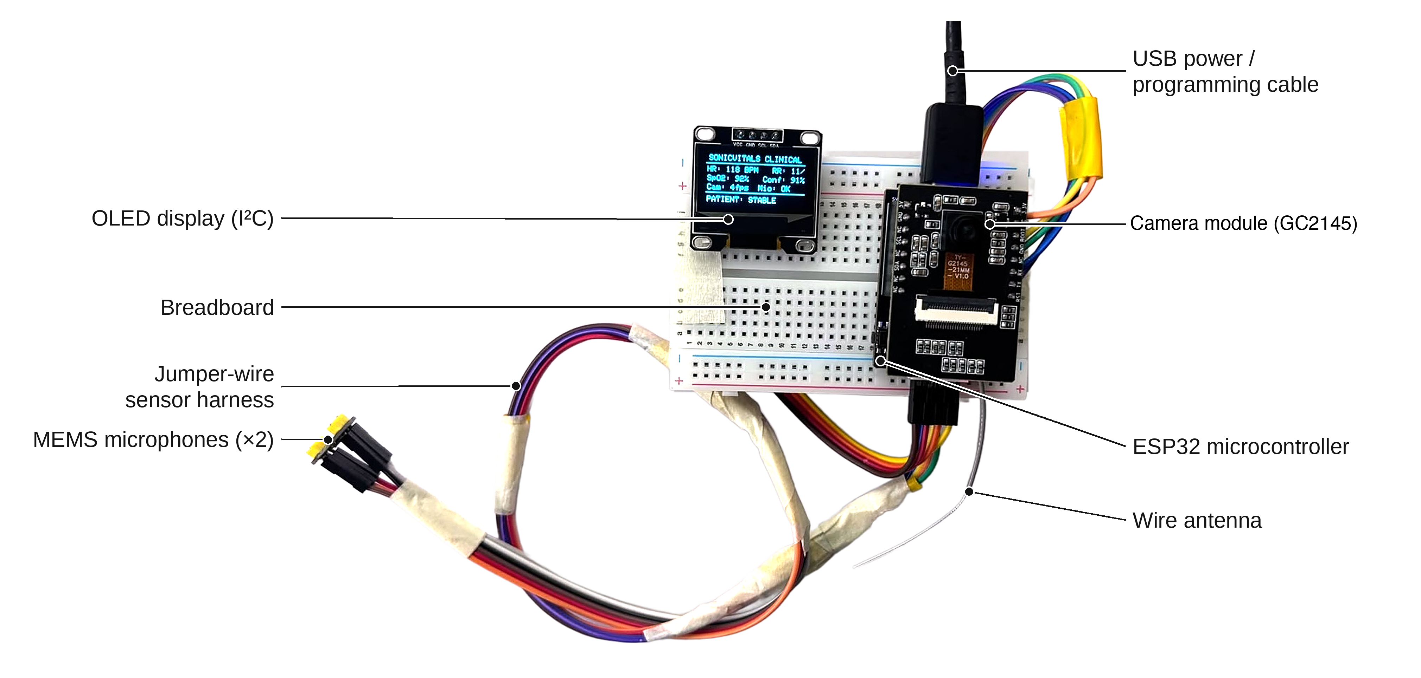
System design
01
Edge node, firmware, data link and architecture

Slide 6
System architecture: three tiers
EDGE NODE · ESP32-S3
PROCESSING ENGINE · PYTHON
WEB DASHBOARD
GC2145 camera · 240 × 160, 10 fps
Face detection + full-face gate
Dashboard
Motion-compensated skin tracking
Skin RGB sums on raw pixels (10 Hz)
Signal Analysis
CHROM · POS · GREEN + SNR gate
Skin-metered exposure control
TS-CAN · PhysNet · EfficientPhys
Diagnostics Studio
INMP441 microphone · I2S 16 kHz
Robust consensus + display stabiliser
Sessions
Breathing fusion · camera HRV
SSD1306 OLED shows the vitals
Device telemetry
Face insights · colour indices
Wi-Fi TCP :3333 → video 5 fps, skin sums 10 Hz, audio 4 kHz, µs time stamps ← ROI boxes, exposure, vitals
REST API polled 4× per second

Slide 7



Edge sensor node hardware
ESP32-S3
Dual-core 240 MHz, PSRAM, Wi-Fi; two FreeRTOS tasks pinned to the two cores
GC2145 camera
2 MP CMOS, RGB565; skin sums computed on raw pixels before JPEG
INMP441 microphone
24-bit I2S MEMS; 63-tap FIR, decimated to 4 kHz
10 fps
240 × 160 camera frames
16 kHz
microphone sampling (I2S)
1 clock
µs time stamps on video, skin sums and audio
SSD1306 OLED
0.96 in, 128 × 64, I2C; shows heart rate, breathing and status

Slide 8



Skin-metered exposure and the data link
Host sends skin boxes
Node sums R, G, B on raw pixels
Host meters skin brightness
Compare with target 165 / 255
CAM:EXP sets sensor exposure
Why meter the skin, not the frame?
Normal auto-exposure follows the whole picture: a bright window leaves the face dark, a dark room clips it. Metering only the skin keeps the face inside the sensor’s linear range, where the 0.1–0.5 % pulse survives. Saturated and near-black pixels are left out of the sums.
Line protocol over TCP (port 3333)
↑ FRAME · JPEG video, 5 fps
↑ RGB · skin sums, 10 Hz
↑ AUDIO · sound blocks
↑ INFO · heap, stack, exposure
↓ ROI · skin boxes
↓ CAM:EXP · exposure
↓ VITALS · for OLED
Newest frame sent first: a slow link drops frames instead of adding delay

Slide 9
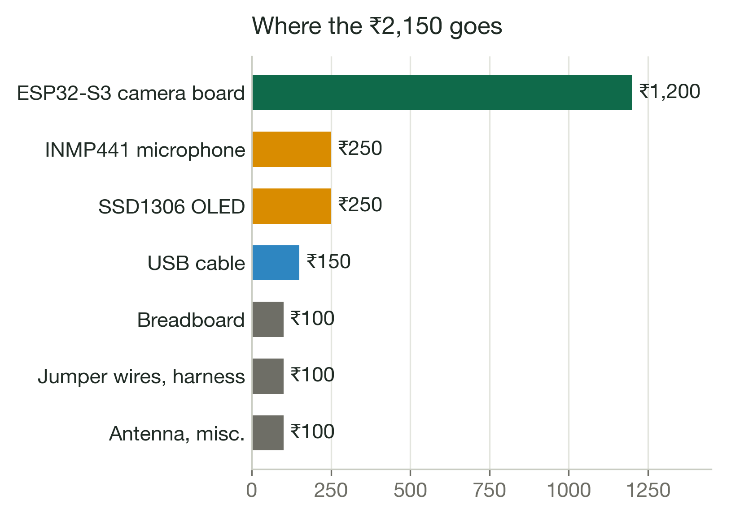
Low-cost prototype
Component | Cost (₹)
ESP32-S3 camera board (with GC2145) | 1,200
INMP441 I2S MEMS microphone | 250
SSD1306 0.96 in OLED | 250
Breadboard | 100
Jumper wires and harness | 100
USB cable | 150
Wire antenna, misc. | 100
Total | 2,150
₹2,150
complete edge node
₹0
software: free and open source

Slide 10
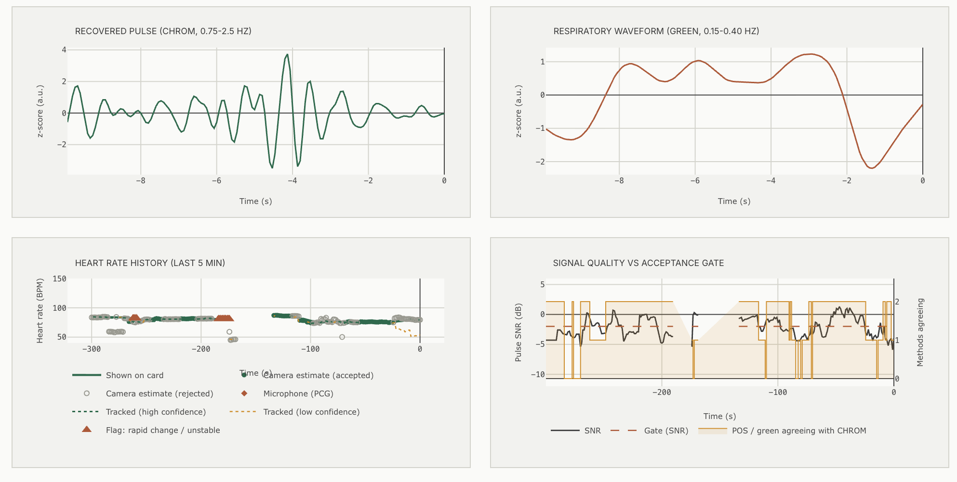
Signal processing
02
From skin colour to one trustworthy heart rate

Slide 11
Processing pipeline: eight stages
Face and full-face gate
Haar cascade every 3rd frame; size, centring and both eyes checked
Skin tracking
Forehead, cheeks and nose follow the face by sub-pixel phase correlation
Artifact repair
Jumps repaired in the derivative domain; still stretch after last movement
Illumination rectification
Background strips remove shared lighting flicker (gated)
1
2
3
4
Pulse extraction
CHROM, POS and GREEN on the 15 Hz skin RGB
Spectrum and quality gate
Welch spectrum, SNR ≥ −2 dB, methods agree within 6 BPM
Consensus
Classic + tracker + TS-CAN, PhysNet, EfficientPhys; median ± 8 BPM
Stabilised display
Holds the value, flags rapid change; badges explain every reading
5
6
7
8
1–4 Signal conditioning
5–6 Pulse and gate
7–8 Fusion and display

Slide 12


Motion compensation lifts the pulse above noise
−4 … −9 dB
pulse SNR before: skin boxes slid over hair and background
Phase correlation
96 × 96 Hann-windowed face template; sub-pixel shift every frame
Incremental search
Starts from the last shift; accepted when response ≥ 0.15 and jump ≤ 0.12 face widths
−1 … +1.5 dB
pulse SNR after, with a still head: above the −2 dB gate
Automatic relock
Face detected again after 8 missed frames or more than 25 % drift
Key fix
The tracking template is copied before phase correlation, so it no longer decays frame by frame.
Fast enough for 30 fps
Detection every 3rd frame, background every 2nd: 21 → 10.6 ms per frame

Slide 13
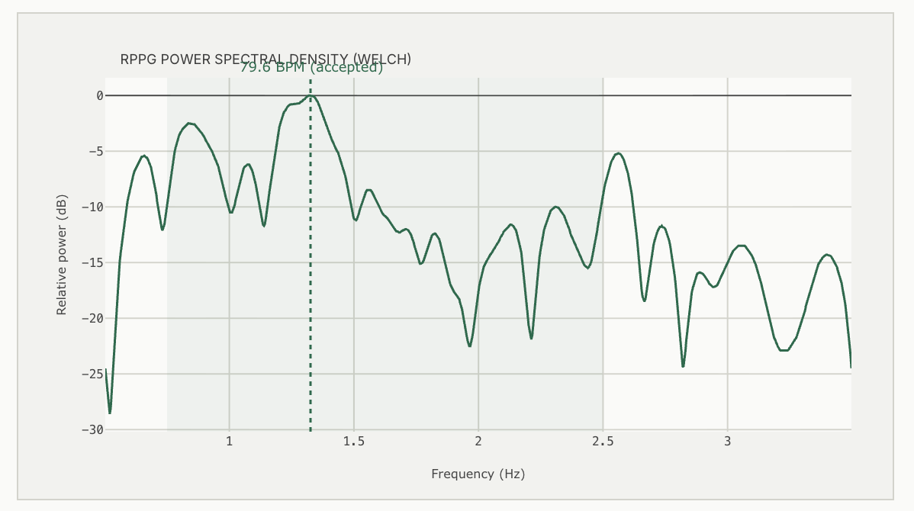
Pulse extraction: three projections of skin colour
CHROM
X = 3R − 2G
Y = 1.5R + G − 1.5B
S = X − (σX / σY)·Y
3 s windows; cancels intensity and specular change
POS
S1 = G − B
S2 = −2R + G + B
P = S1 + (σS1 / σS2)·S2
1.6 s windows; plane orthogonal to skin tone
GREEN
detrended green channel
Reference only: strongest pulse, no motion rejection
Spectrum and SNR
Welch spectrum of the pulse; heart-rate band 0.75–2.5 Hz (45–150 BPM); peak tracked near the last accepted value.
SNR = 10·log10 [ P(f0 ± 0.1 Hz) + P(2f0 ± 0.2 Hz) ] / P(rest of 0.5–4 Hz)

Slide 14
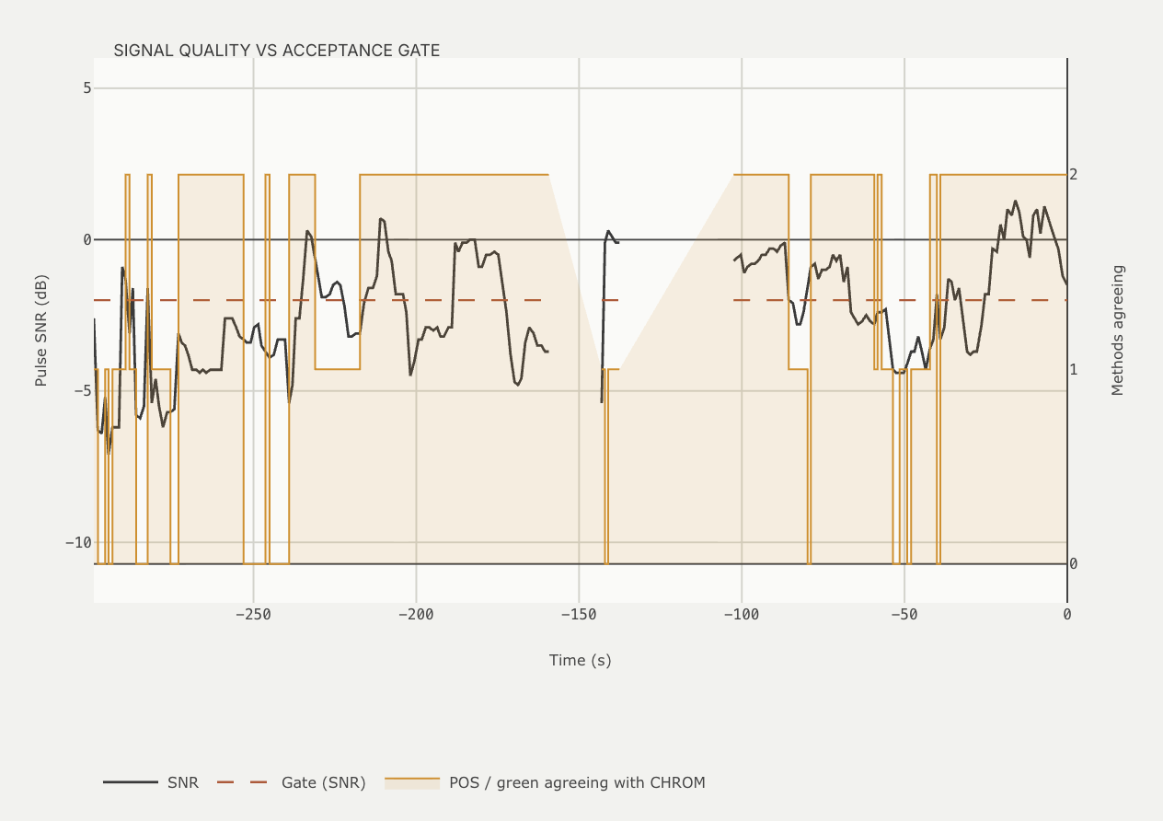
Quality gate: show a number only when it is real
SNR ≥ −2 dB (de Haan)
POS and GREEN agree with CHROM within 6 BPM
≥ 80 % real frames, ≤ 15 % repaired
≥ 10 s of full-face, gated frames
Peak inside 45–150 BPM, lighting peaks rejected
1.56 BPM
MAE with the gate (2.30 without)
19 %
hardest windows withheld, not shown wrong
Live: pulse SNR (black) against the −2 dB gate (dashed); amber = methods agreeing

Slide 15
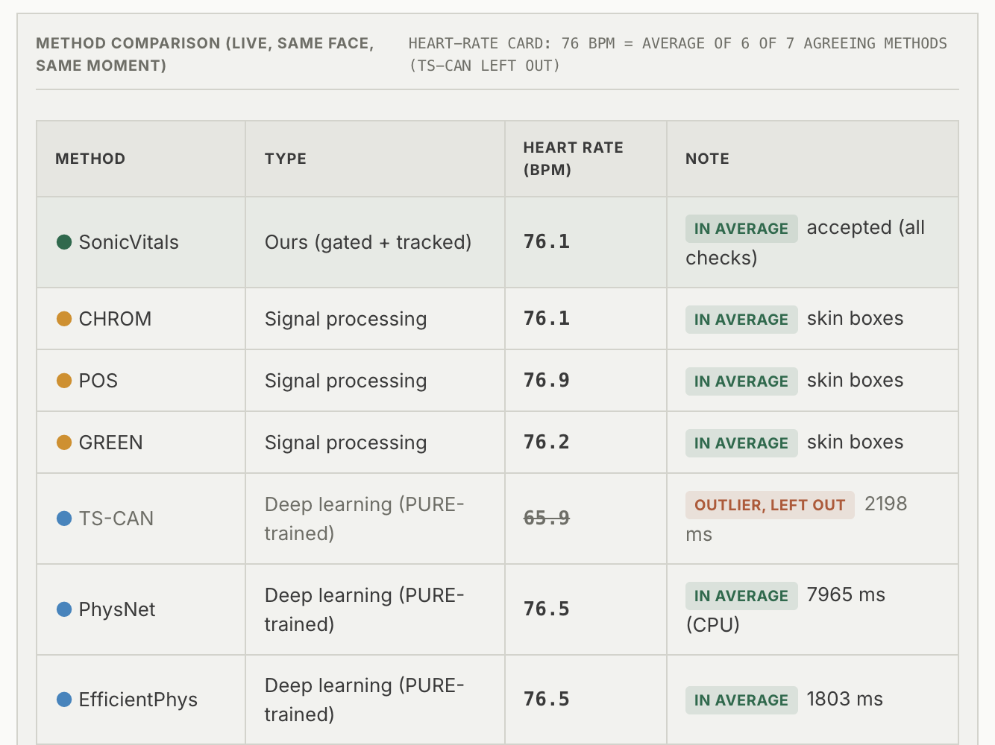
Robust consensus: seven methods, one heart rate
CHROM
POS
GREEN
Bayes tracker
TS-CAN
PhysNet
EfficientPhys
Median → keep methods within ± 8 BPM → average
≥ 3 methods and ≥ half agree → value shown
≥ 4 methods, 60 % + a deep model → CONFIRMED
76 BPM
6 OF 7 METHODS AGREE · TS-CAN LEFT OUT
Live comparison on the same face, at the same moment

Slide 16
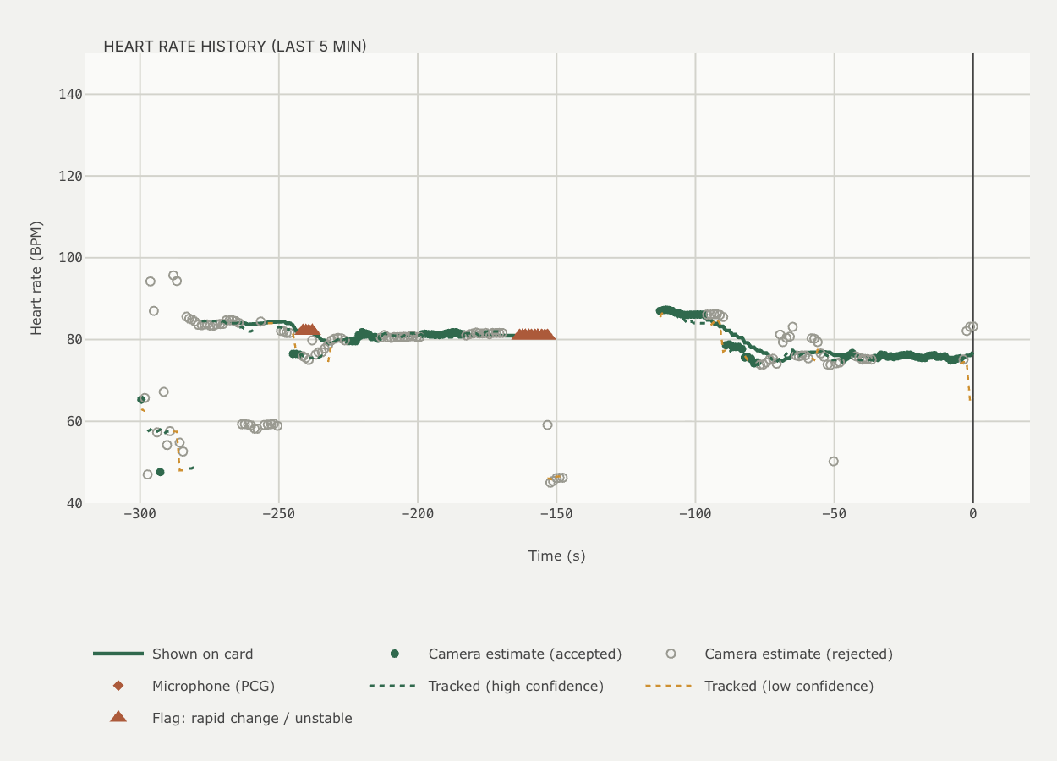
Display stabiliser: steady values, honest flags
STABLE
≥ 4 methods agree incl. a deep model
CHANGE CONFIRMED
new level seen 4 times
ACQUIRING
collecting first estimates
LOW CONFIDENCE
value shown, fewer methods agree
HOLDING LAST VALUE
no fresh estimate, up to 15 s
NO SIGNAL
no face or usable pulse
RAPID CHANGE – HELD
jump > 8 BPM not yet confirmed
UNSTABLE
estimates scatter widely
METHODS DISAGREE
no majority within ± 8 BPM
8 BPM
jump threshold
× 4
confirmations
15 s
hold time
Heart-rate history: card value, accepted (filled) and rejected (hollow) estimates, red flags

Slide 17
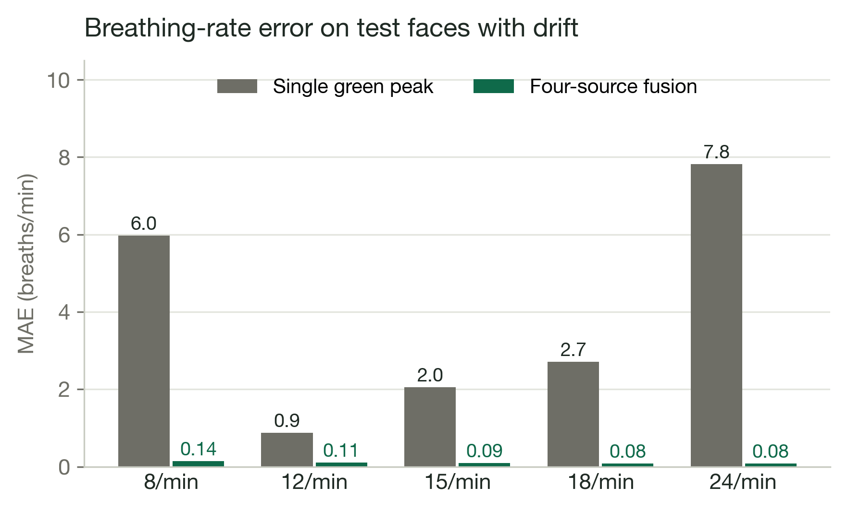

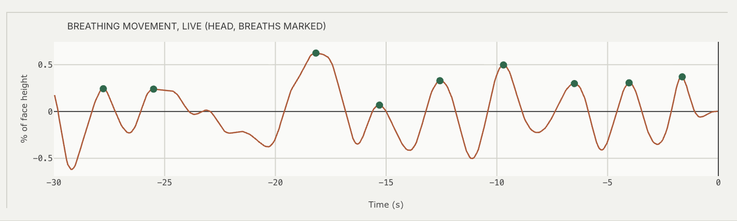
Breathing rate: four sources, one agreement
Skin brightness
RIIV
Pulse height
RIAV
Pulse rate
RIFV
Head motion
vertical sway
Agreement fusion
Detrend 0.07 Hz · whiten · search 6–36 /min · ≥ 2 sources within 4 /min · ≥ 20 s of still data
Pattern: REGULAR · IRREGULAR (CV > 30 %) · PAUSE (≥ 8 s)
Live: card 18–19 /min vs 16–20 /min counted on the graph

Slide 18
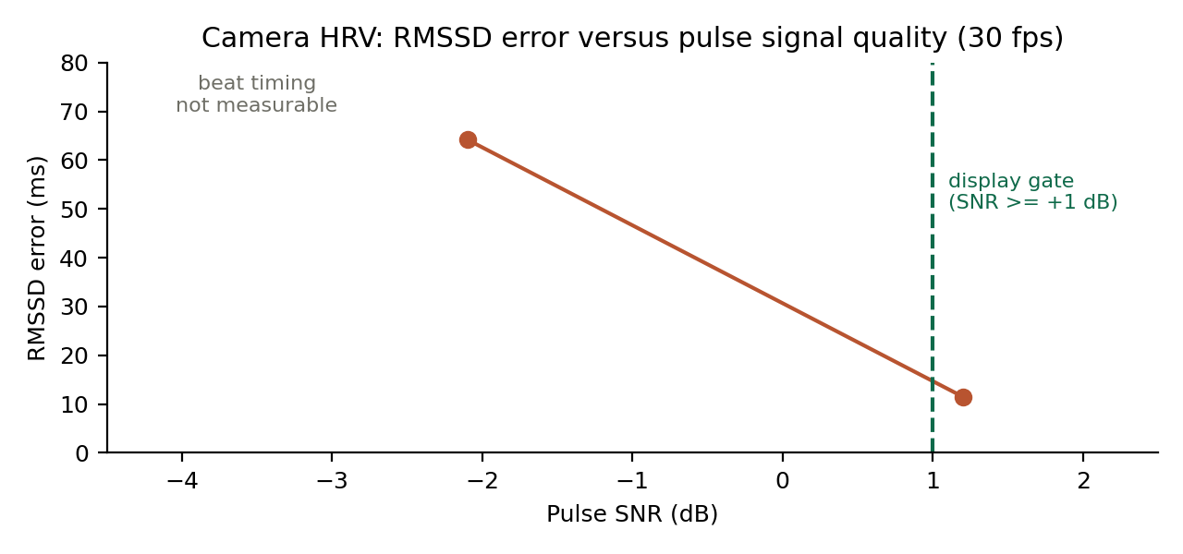
Heart-rate variability from the camera
Beat times
CHROM pulse at 30 Hz, band 0.7–3.5 Hz, spline × 8, peaks ≥ 0.6 beat apart
1
Clean intervals
Within ± 20 % of the median; ≥ 15 intervals and ≥ 80 % clean
2
RMSSD
√ mean of squared differences of successive intervals
3
11 ms
RMSSD error at +1 dB pulse SNR
64 ms
error at −2 dB: why HRV is gated
Shown only when
≥ 20 fps, pulse SNR ≥ +1 dB, result 5–150 ms, HR within 8 BPM of the card
4
Beat timing needs a clean pulse: noise shifts peaks by tens of ms

Slide 19
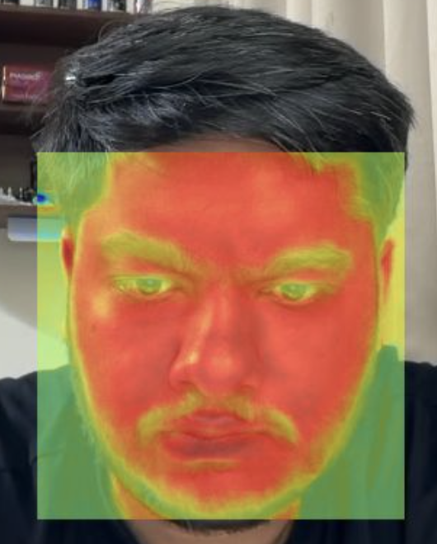
Face insights and dashboard
03
Blood flow, liveness, blinks, head steadiness and the analysis views

Slide 20
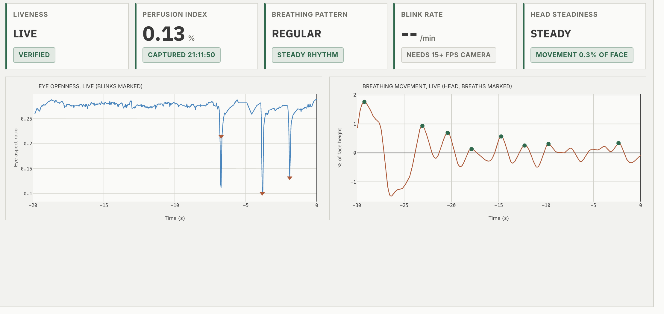


Face insights from the same camera
Blood-flow map
30 s still capture
Liveness
pulse or blinks
Perfusion index
pulse strength %
Breathing pattern
regular / pause
Blink rate
eye aspect ratio
Head steadiness
RMS movement

Slide 21
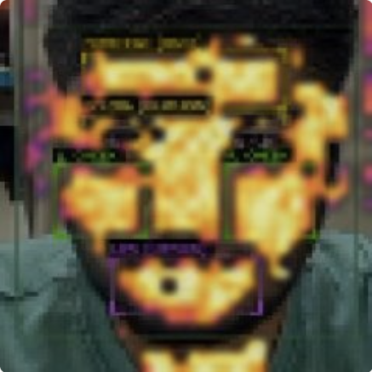
Blood-flow map and perfusion index
32 × 32 skin cells
colour trace of every cell over a 30 s still capture
1
Lock-in at the heart rate
in-phase amplitude against the face-wide pulse
2
Noise-referenced score
z against off-frequency noise; z ≥ 2.5 coloured
3
Synthetic test face (validation)
Live capture from the webcam
Robust capture
restarts on > 3 % movement; coarser grid if coverage < 30 %
94 %
synthetic skin mapped
7 → 46 %
live skin mapped
PI = 2A
× 100 %: pulsatile AC / DC
4

Slide 22
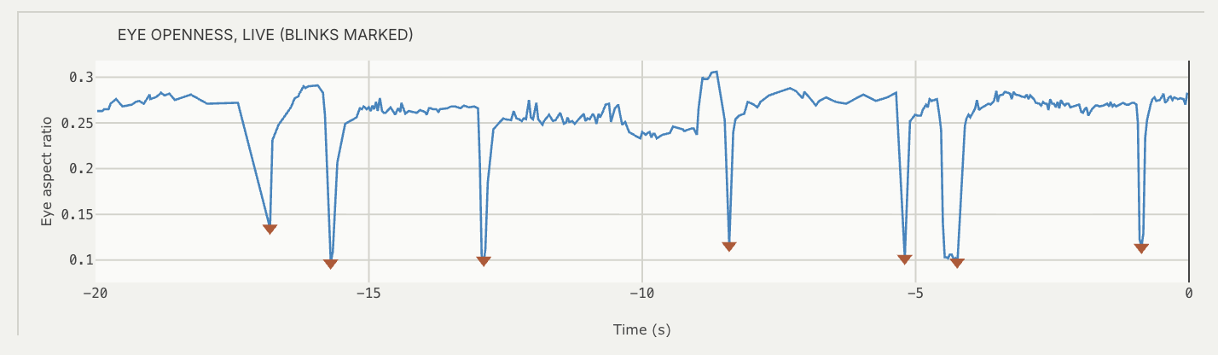
Liveness, blinks and head steadiness
Liveness
Is a living face in front of the camera?
Blink rate
MediaPipe Face Mesh, 478 landmarks
Head steadiness
Movement and pose of the head
13/13
photos → NO PULSE
5/5
pulsing faces → LIVE
EAR = ( |p2 − p6| + |p3 − p5| ) / 2|p1 − p4|
< 1.5 % STEADY
1.5–4 % SLIGHT MOVEMENT
LIVE when
skin pulses in phase (evidence ≥ 0.15) or ≥ 2 blinks in 30 s. NO PULSE needs evidence < 0.08 three times and no blinks.
> 4 % MOVING
20 / 20
detected blinks, checked frame by frame, were real (dip ≥ 35 % of median EAR, ≤ 0.5 s)
How
RMS of face movement over 10 s as % of face width; yaw, pitch and roll from solvePnP on mesh landmarks. Steadiness also decides when breathing and the map may use the data.

Slide 23
Dashboard: live vitals with their evidence
Recovered pulse
CHROM, band-passed 0.75–2.5 Hz, z-scored
1
2
1
Respiratory waveform
fused breathing signal, 0.1–0.6 Hz
2
3
4
Heart-rate history
card value, accepted / rejected estimates, flags
3
Quality vs gate
pulse SNR against −2 dB, methods agreeing
4
HEART RATE
consensus, BPM
BREATHING
fusion, /min
HRV
RMSSD, ms
QUALITY
peak share, %
HR SOURCE
methods used
Every card: one large value and one status badge (green verified, amber estimate, red flag, grey none); the reason is in the tooltip.

Slide 24
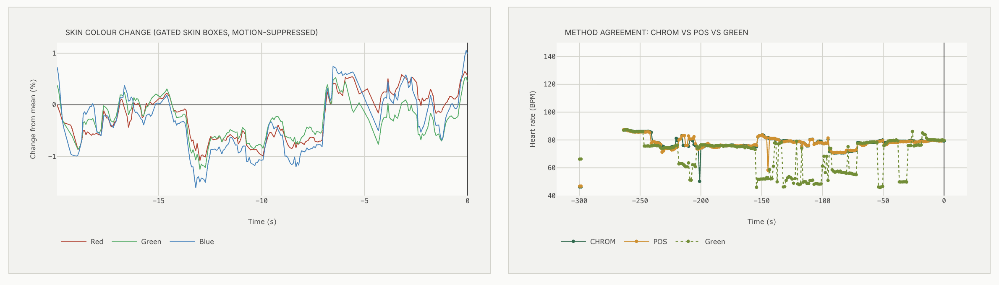
Signal Analysis: the engineering view
Cardiac peak f0
CHROM spectrum peak; BPM = 60 × f0
SNR (de Haan)
f0 and 2f0 power vs rest, dB
Spectral concentration
share of band power at the peak
Respiration fr
fused breathing rate / 60
Methods agreeing
POS, GREEN vs CHROM; % repaired
Video source
camera and measured fps
Graphs: power spectrum · microphone spectrogram · standardized pulse · moving-average decomposition · skin colour change · method agreement

Slide 25
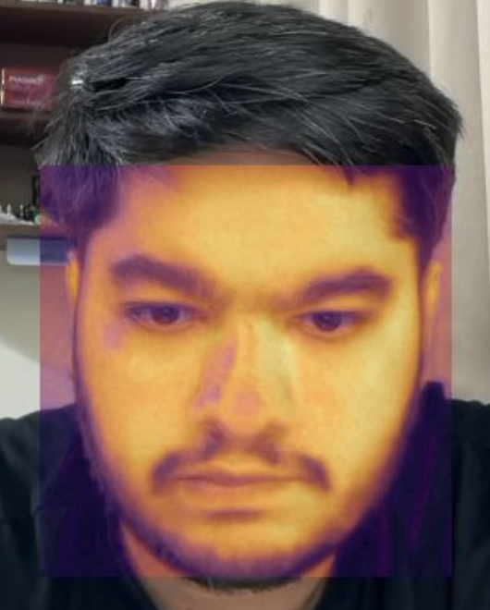
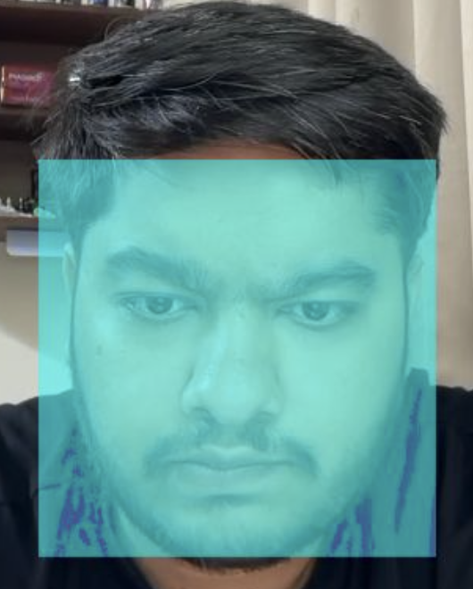
Diagnostics Studio: colour indices from one sharp frame
Erythema EI
100 (log10 R − log10 G), forehead · 8–23
Pallor PI
(G + B) / 2R, both cheeks · < 0.72
Eye-band yellow YI
100 (R + G − 2B) / (R + G + B) · < 12
Lip blue/red CR
B / R, lips · < 0.76
R − G · redness
CIELAB b* · yellowness
B / R · blueness
Sharpest frame (8 s)
5 face regions
Colour means
Indices
Range check
Asymmetry HFI
100 |G left − G right| / sum · < 5 %
Exploratory, uncalibrated software ranges: not a diagnosis

Slide 26
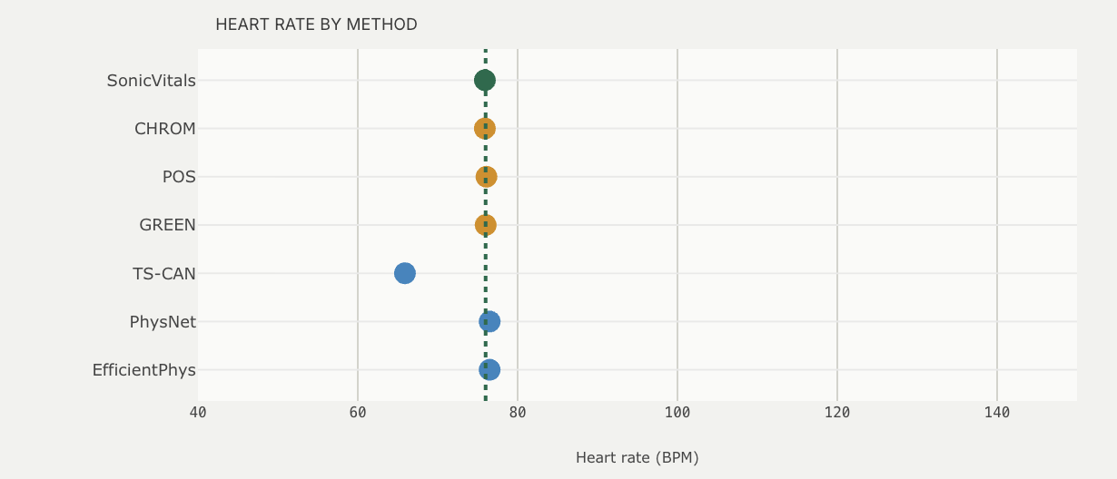
Results
04
Benchmark accuracy, live operation and impact

Slide 27
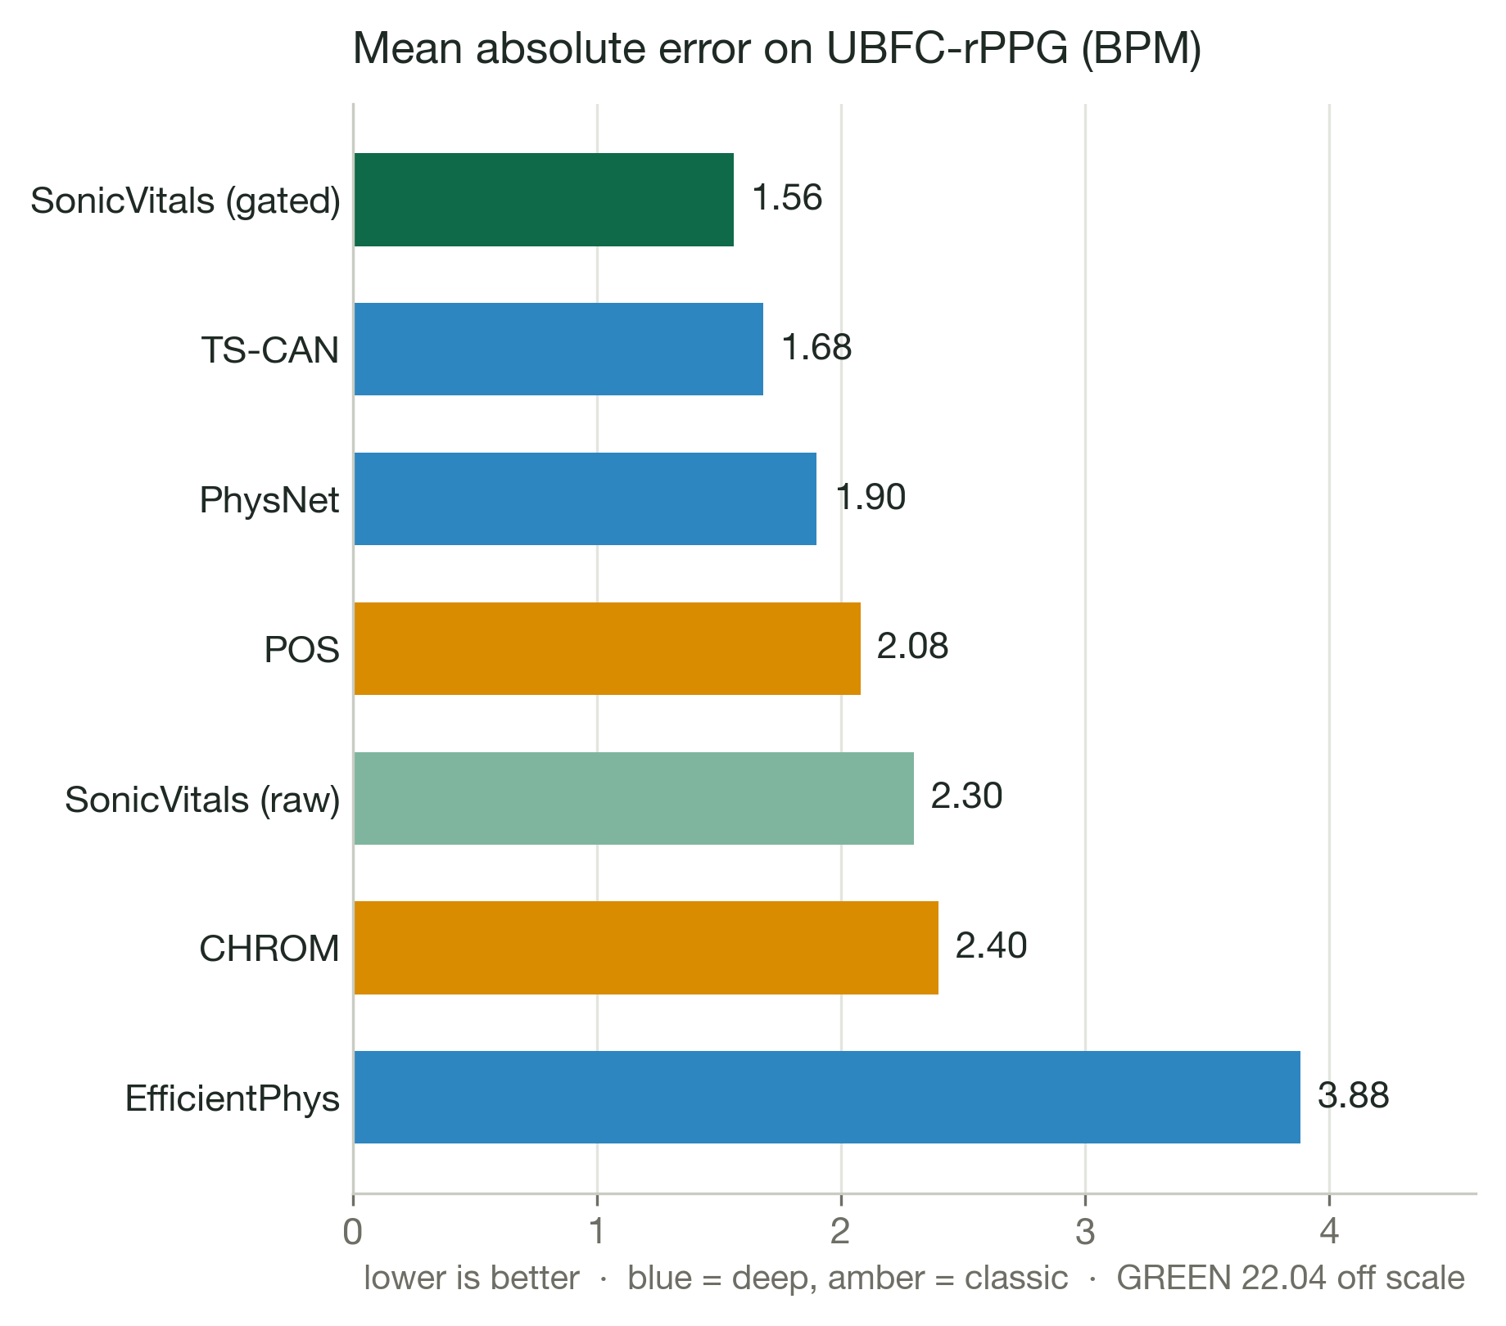

Heart-rate accuracy on UBFC-rPPG
1.56
BPM mean absolute error
2.73
BPM root-mean-square error
0.99
Pearson correlation r
93 %
of windows within 5 BPM
Protocol
10 subjects, 30 s windows, contact PPG as reference. The quality gate withholds the 19 % hardest windows; about 72 ms of processing per window.

Slide 28
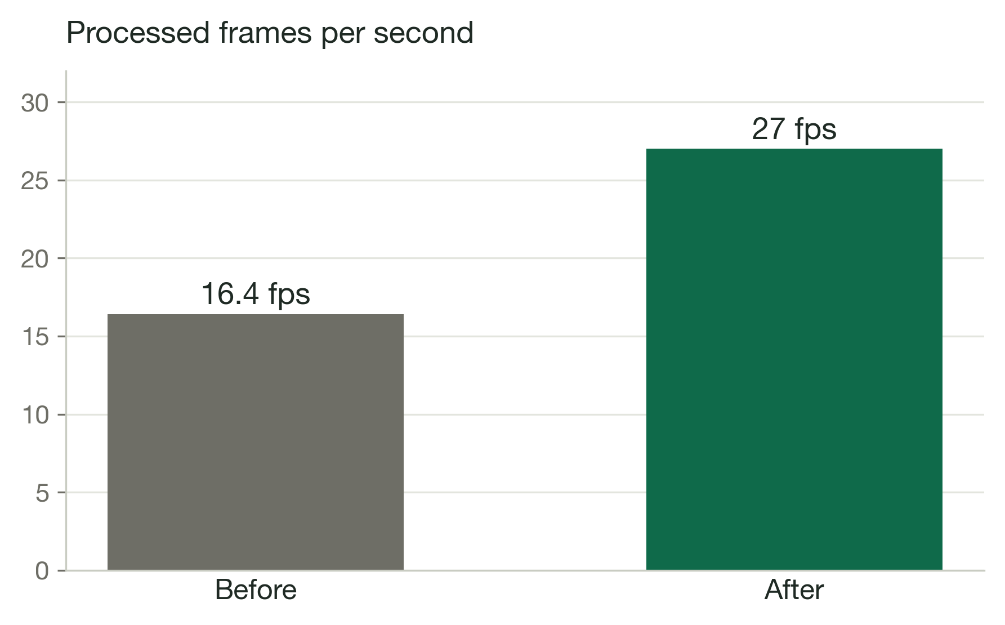
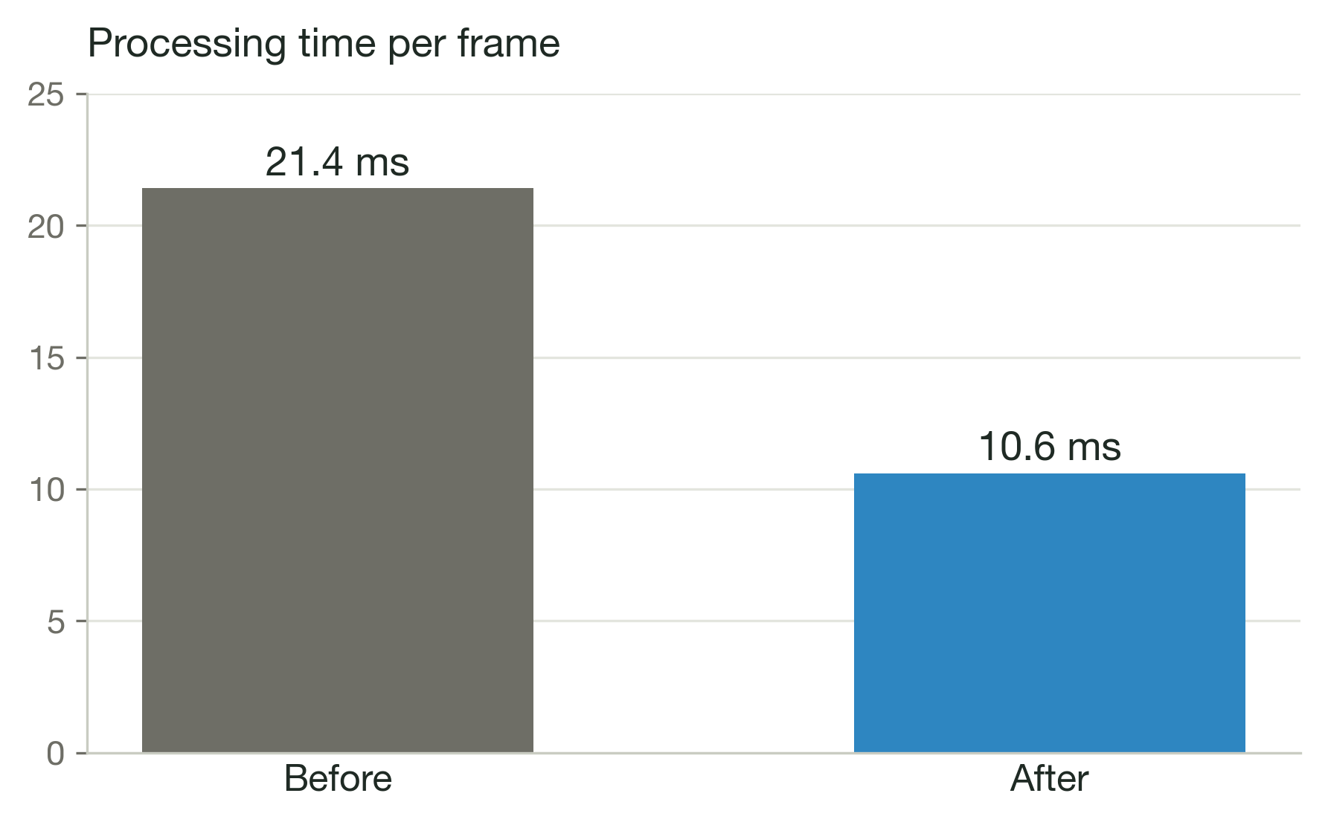
Live operation
27 fps
processed (was 16.4)
10.6 ms
per frame (was 21.4)
6–7 of 7
methods agree, 76–83 BPM
18–19
br/min vs 16–20 counted

Slide 29


Tools and technology
Firmware
Signal processing
AI models
Web dashboard
Arduino framework
Python 3.10
PyTorch
Flask REST API
PlatformIO
NumPy, SciPy
rPPG-Toolbox weights
HTML, CSS, JavaScript
FreeRTOS, two cores
OpenCV
TS-CAN, PhysNet, EfficientPhys
Plotly.js
ESP32 camera driver
Welch, Butterworth
MediaPipe Face Mesh
4 updates per second

Slide 30
Work plan and team
Jul
Problem, literature, plan
Sep
MATLAB rPPG prototype
Mid Oct
Exposure control, UBFC benchmark
Oct
Testing, report, viva
1
2
3
4
5
6
7
Aug
Design, components
Early Oct
Edge node, firmware, Wi-Fi
Late Oct
Consensus, breathing, HRV, insights
Janhavee Dhote · 24BML0120
Literature survey, UBFC-rPPG benchmark, result analysis, documentation
Pratik Kumar · 24BML0027
Signal-processing engine, fusion, breathing, HRV, face insights, dashboard, integration
Uday Krishan Khandelwal · 24BML0012
Edge node hardware, ESP32-S3 firmware, camera and microphone interfacing, testing

Slide 31


Social and environmental impact
SDG 3
Good health and well-being
SDG 9
Industry, innovation and infrastructure
SDG 10
Reduced inequalities
Low-cost contactless screening for homes, clinics and remote care
Open hardware and software built from commodity parts
No specialised medical equipment: a ₹2,150 node and a laptop
No consumables
No electrodes, gel or probe covers to throw away
Low power
USB-powered node; reuses an existing laptop
Repairable
Modular parts can be replaced or reused individually

Slide 32

Conclusion and future work
What we achieved
Next steps
A complete low-cost contactless system: edge node, quality-gated engine, explainable dashboard
Full UBFC, PURE and VIPL-HR benchmark; validation against ECG and oximeter across skin tones
Most accurate method on UBFC-rPPG: MAE 1.56 BPM, r = 0.99
Stethoscope coupling and validation of the acoustic channel
Real time at about 30 fps with seven methods in consensus
Calibrated SpO₂ and infrared illumination for low light
Breathing, HRV, blood-flow map, liveness, blinks and colour indices from one camera
Faster edge video for camera HRV and deep models on the node

Slide 33
Thank you
Questions and discussion
Janhavee Dhote
24BML0120
Pratik Kumar
24BML0027
Uday Krishan Khandelwal
24BML0012
Guide: Jeeva J. B.
School of Electronics Engineering (SENSE), VIT

